Slide 1

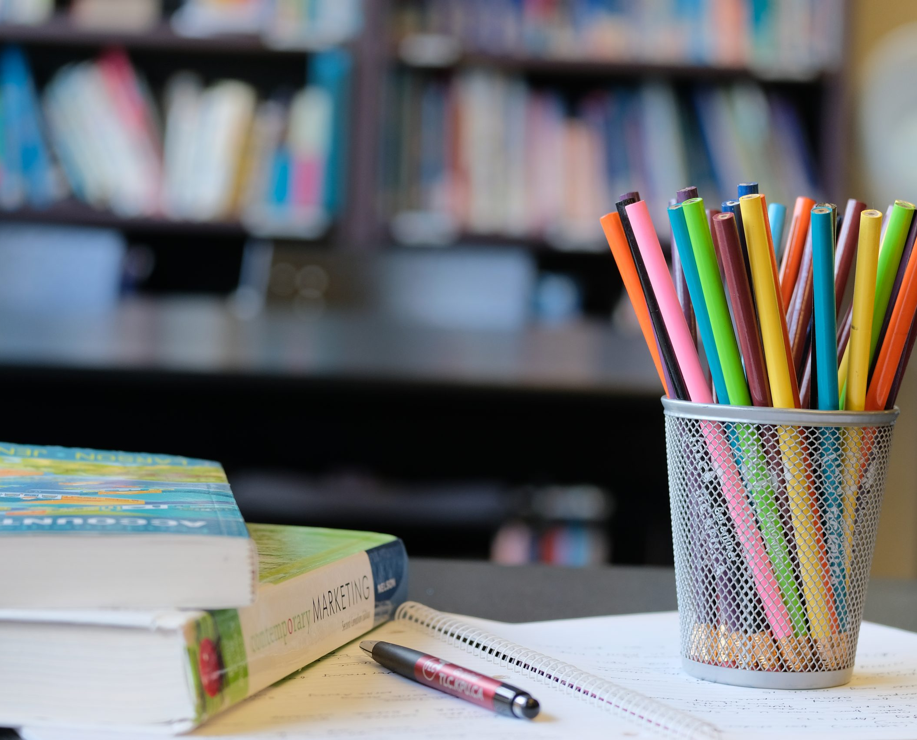
Welcome TO PSS-1
university
QUANT &
REASONING

Slide 2
Averages & Alligations

Slide 3
Averages
Average is a very simple topic and just involves simple mathematical calculations. Average concept has various applications. We will discuss its applications in next session. Firstly we will try to make you understand the basics of this topic.
Average is just a mean value of all the given observations or we can say it is an arithmetic mean of observations.
Average = Sum of all observations / Number of observations

Slide 4
Properties of Average
Average lies between Maximum and Minimum Observation.
When the Same value a is added to each data/observation, then the New average = original average+ a
When the Same value a is subtracted from each data/observation, then the New average = original average- a
When the Same value a is Multiplied to each data/observation, then the New average = original average * a
If ‘x’ and ‘y’ are the average of group ‘a’ and ‘b’ respectively then combined average of two groups given by =
(ax+by) / (a+b)

Slide 5
Averages
1. The average weight of 40 Students is 32. If the Heaviest and Lightest are excluded the average weight reduces by 1. If only the Heaviest is excluded, then the average is 31. Then what is the weight of the Lightest? a. 30 b. 31 c. 32 d. 33

Slide 6
Averages
2. 8 years ago there were 5 members in the Arthur's family and then the average age of the family was 36 years. Meanwhile Arthur got married and gave birth to a child. Still the average age of his family is same now. What is the age of his wife at the time of his child's birth was, if the difference between the age of her child and herself was 26 years?
a. 25 yrs b. 26 yrs c. 20 yrs d. cannot be determined

Slide 7
Averages
3. The average weight of 45 passengers in a bus is 52 kg. 5 of them whose average weight is 48 kg leave the bus and other 5 passengers whose average weight is 54 kg join the bus at the same stop. What is the new average weight of the bus?
a. 54.21 kgs b. 51.07 kgs c. 52.66 kgs d. 53.45 kgs

Slide 8
Averages
4. In the first 39 overs of a cricket match, the run rate was 4.6 runs/over. Calculate the required run rate in the remaining 11 overs to reach the target of 252 runs?
a. 7.2 b. 5.7 c. 6.3 d. 6.6

Slide 9
Averages
5. Sriram was conducting an experiment in which the average of 11 observations came to be 92, while the average of first five observations was 89, and that of the last five was 86. What was the measure of the 6th observation?
a. 134 b.137 c. 139 d. 141

Slide 10
Averages
6. A car owner buys petrol at Rs.7.50, Rs. 8 and Rs. 8.50 per liter for three successive years. What approximately is the average cost per liter of petrol if he spends Rs. 4000 each year?
a. Rs. 7.98 b. Rs. 8 c. Rs. 8.50 d. Rs. 9

Slide 11
Averages
7. The mean (Average) of 50 numbers is 30. Later, it was discovered that two entries were wrongly entered as 82 and 13 instead of 28 and 31. Find the correct mean.
a. 36.12 b. 30.66 c. 29.28 d.38.21

Slide 12
8. The average age of a husband and wife 5 years ago, was 25 years at that time. The average age of the family including the husband, the wife and the children who were born during the interval 16 years now. How old are the children now? (All of them have different ages with integral values)
1 year, 3 years b.4 years, 1year c.2 years, 3 years d.2 years, 2 years
Averages

Slide 13
Averages
9. A set of consecutive positive integers beginning with 1 is written on the blackboard. A student came along and erased one number. The average of the remaining numbers is 35 7/17.
What was the erased number?
a.7 b.8 c.9 d. None of these

Slide 14
10. A vegetable vendor mixes 68 kgs of tomatoes purchased at Rs. 63 per kg with 85 kgs of tomatoes purchased at Rs. 81 per kg. Find the average cost price of the resultant tomatoes per kg.
a.Rs.68 b. Rs. 70 c. Rs.73 d. Rs.72
Averages

Slide 15
11. Kritika is on a 4 days trip with school mates. She had decided to keep her average expense for 4 days at Rs 80. However, at the end of third day she realized that her expenses on first three days were Rs 80, Rs 90, Rs 110 and respectively. How much should she spend on 4th day to ensure that she meets her targeted average expense? a. Rs. 40 b. Rs. 60 c. Rs. 90 d. Rs. 220
Averages

Slide 16
Averages
12.The cargo ship was carrying gas cylinders from Australia to New Zealand. 3 cylinders with average weight X Kg belonged to a single owner. Last minute one of the cylinders weighing 85 kg was replaced by another cylinder leading to a rise in average weight of the 3 cylinders by 7 kg. Find the weight of the new cylinder. a. 79 kg b. 92 kg c. 106 kg d. 109 kg

Slide 17
Averages
13. There are 100 students in 3 sections A, B and C of a class. The average marks of all the three sections was 84. The average of B and C was 87.5 and the average marks of students in A section was :
a.20 b.35 c.54 d.40

Slide 18
Averages
14.On a school’s Annual day sweets were to be equally distributed amongst 112 children. But on that particular day, 32 children were absent. Thus the remaining children got 6 extra sweets. How many sweets was each child originally supposed to get ?
a.14 b.16 c.12 d.15

Slide 19
Alligations
Mixture : It is a combination of two or more quantities
Allegation : It is the rule that enable to find the ratio in which two or more ingredients in the given price must be mixed to produce a mixture of a desire price.
Mean Price : The cost price of the unit quantity of the mixture is called Mean price

Slide 20
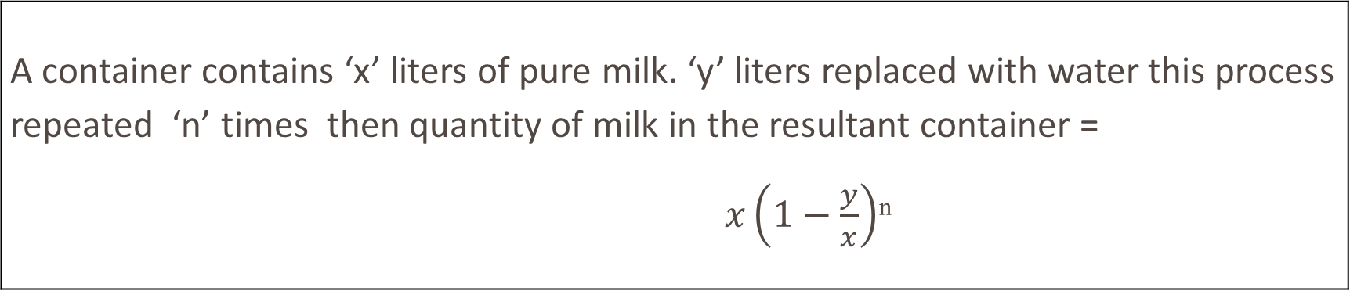
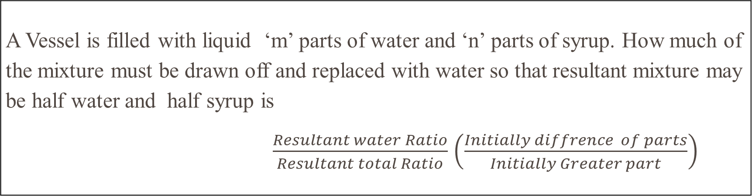
Alligations
A Vessel is filled with liquid ‘m’ parts of water and ‘n’ parts of syrup. How much of the mixture must be drawn off and replaced with water so that resultant mixture may be half water and half syrup is $\frac{Resultant water Ratio}{Resultant total Ratio}$ $\left(\frac{Initially diffrence of parts}{Initially Greater part}\right)$
A container contains ‘x’ liters of pure milk. ‘y’ liters replaced with water this process repeated ‘n’ times then quantity of milk in the resultant container = $x\left(1−\frac{y}{x}\right)$^{n}

Slide 21
Alligations
15.In what ratio must a grocer mix two varieties of tea worth Rs. 70 a kg and Rs. 76 a kg so that by selling the mixture at Rs. 87 a kg he may gain 16%?
a. 1: 5 b. 5: 1 c. 11: 17 d. 4: 5

Slide 22
Alligations
16. In what ratio must water be mixed with milk to gain 20 % on selling the mixture at C.P?
1: 5 b. 5: 1 c. 2: 3 d. 4: 3

Slide 23
17. How many kg of sugar costing Rs.11 per kg must be mixed with 21 kg of sugar costing Rs.9 per kg, so that there is a gain of 10 % by selling the mixture at Rs.10.45 per kg.
a.6 kg b.7 kg c.9 kg d.10 kg
Alligations

Slide 24
18. Tea at Rs 120 per kg and at Rs.130 per kg are mixed with a third variety in the ratio 1:1:2. If the mixture is worth Rs.137.5 per kg the price of the third variety per kg in Rs. is?
a.150 b. 155 c. 145 d. 140
Alligations

Slide 25
19. A vessel is filled with liquid, 5 parts of which are water and 7 parts syrup. How much of the mixture must be drawn off and replaced with water so that the mixture may be half water and half syrup?
a.1/3 b.1/4 c.1/5 d.1/7
Alligations

Slide 26
Alligations
20.Ratios of milk and water in two solutions are 2: 3 and 3: 2 respectively. Content of these two solutions are mixed in the ratio 1: 4. Find the ratio of milk and water in the resultant solution.
a. 12: 13 b. 14: 11 c.13: 2 d. 11: 14

Slide 27
21. Two solutions of milk and water are mixed in the ratio 2: 3 by volume. The resulting solution contains 40 % milk. Find milk concentration in the first solution if the concentration of milk in the second is 60%
a.20% b. 15% c.10% d.5%
Alligations

Slide 28
Alligations
22. The cost of oil is Rs. 100 per kg. After adulteration with another oil, which costs Rs.50 per kg, Ram sells the mixture at Rs. 96 per Kg, thereby making a profit of 20%. In what ratio does he mix the two kinds of oil?
a. 1: 2 b. 3: 2 c. 3: 1 d. 3: 4

Slide 29
23. Goods are purchased for Rs. 450 and one – third of them are sold at a loss of 10%. At what profit percentage should the remainder be sold so as to gain 20% on the whole transaction?
a.15% b.25% c.35% d.45%
Alligations

Slide 30
24.From a solution containing milk and water in the ratio 3: 4, 10 L is removed and replaced by water. If the resulting solution contains milk and water in the ratio 1: 2 then what was the volume of the original solution?
a.40L b.45L c.35L d.42L
Alligations

Slide 31
25. A container contains pure milk. 10% of this is removed and replaced with water. Then 25% is removed and replaced with water and finally 30% is removed and replaced with water. What is the percentage of milk in the final solution?
a.65% b.47.25% c.50% d.48.75%
Alligations

Slide 32
Alligations
Key:
1.B | 2.B | 3.C | 4.D | 5.B | 6.A | 7.C | 8.A | 9.A | 10.C
11.A | 12.C | 13.A | 14.D | 15.A | 16.A | 17.C | 18.A | 19.D | 20.B
21.C | 22.B | 23.C | 24.B | 25.B

Slide 33


Slide 34

This Photo by Unknown Author is licensed under CC BY-SA

